Slide 1
LLMs
Transformers
Prompting
RAG
Quantization
Fine Tuning

Slide 2
Recap
Encoder-Decoder
Attention
Self Attention
Multi-head Attention
Transformer Architectures

Slide 3
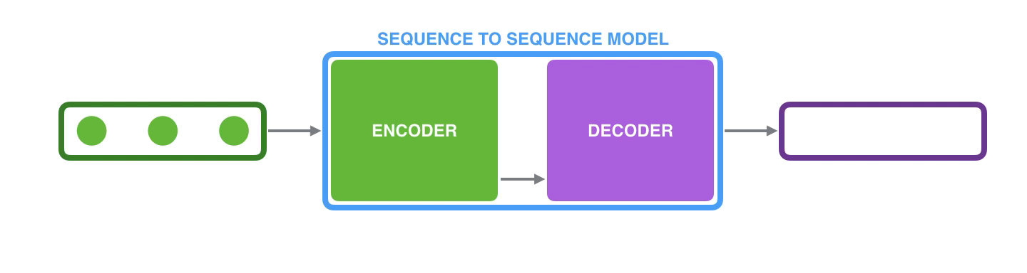
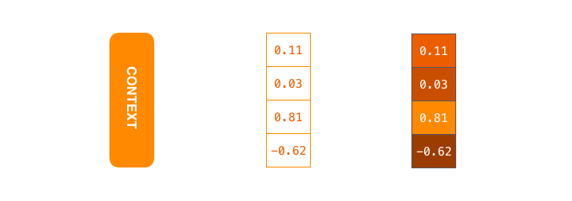
Recap
Encoder-Decoder
Attention
Self Attention
Multi-head Attention
Transformer Architectures
Context is the bottleneck

Slide 4
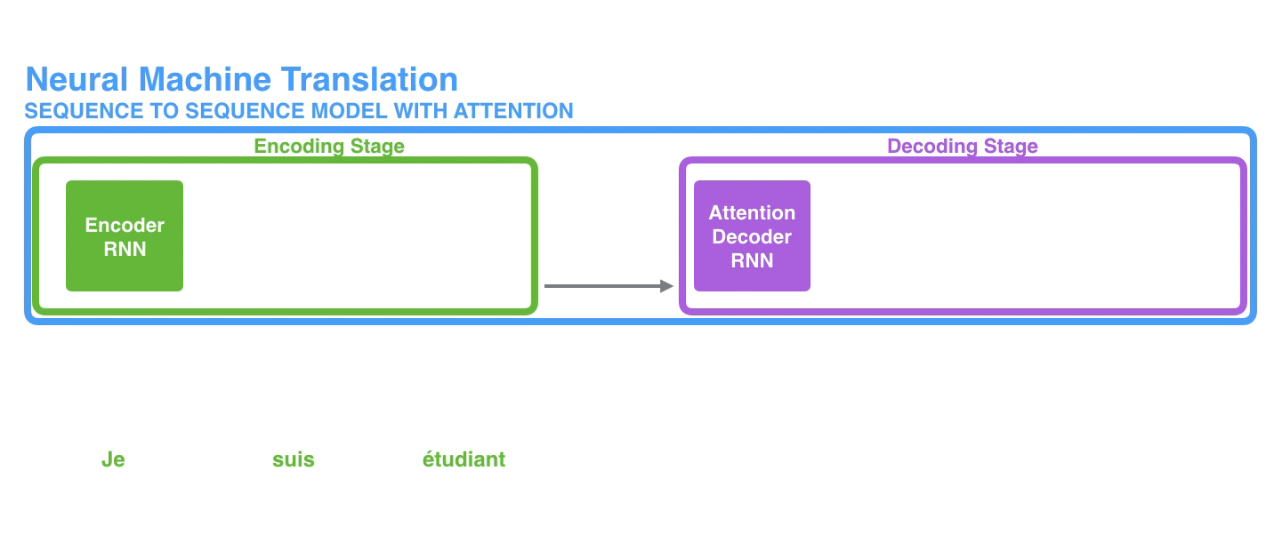
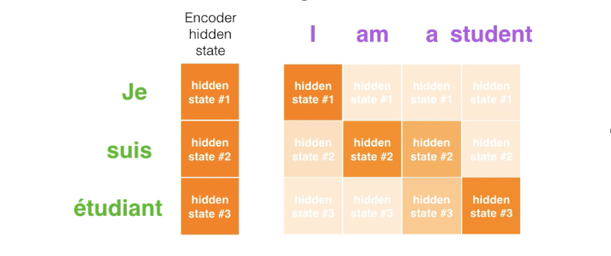
Recap
Encoder-Decoder
Attention
Self Attention
Multi-head Attention
Transformer Architectures

Slide 5
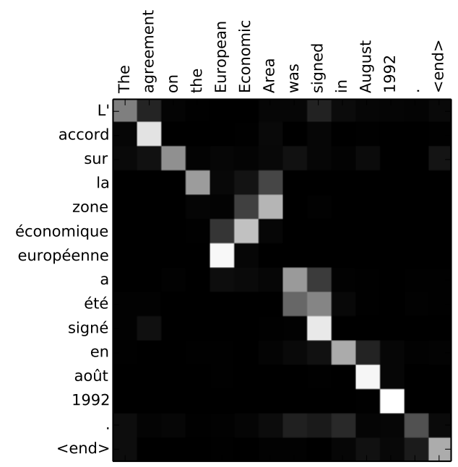
Recap
Encoder-Decoder
Attention
Self Attention
Multi-head Attention
Transformer Architectures

Slide 6
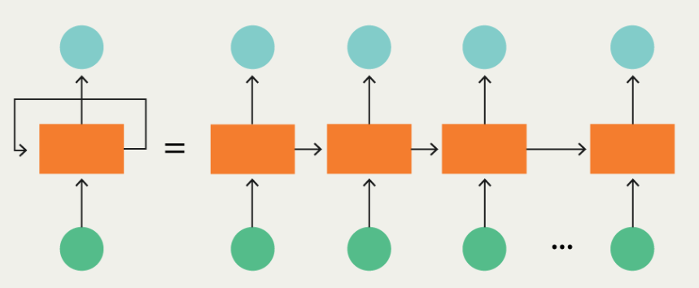

Recap
Seq 2 Seq : Complex
One token at a time
Each unit is a bottle neck to the flow of information
To compute the final unit output, we first have to compute all the previous unit’s output
Encoder-Decoder
Attention
Self Attention
Multi-head Attention
Transformer Architectures
Self Attention [Vaswani et al 2017, Attention is all you need]
Attention + CNN
Sequential
Parallel

Slide 7
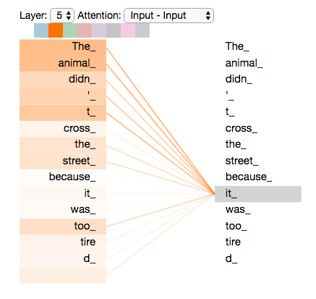
Recap
Encoder-Decoder
Attention
Self Attention
Multi-head Attention
Transformer Architectures

Slide 8
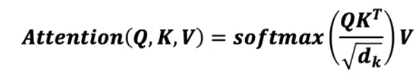
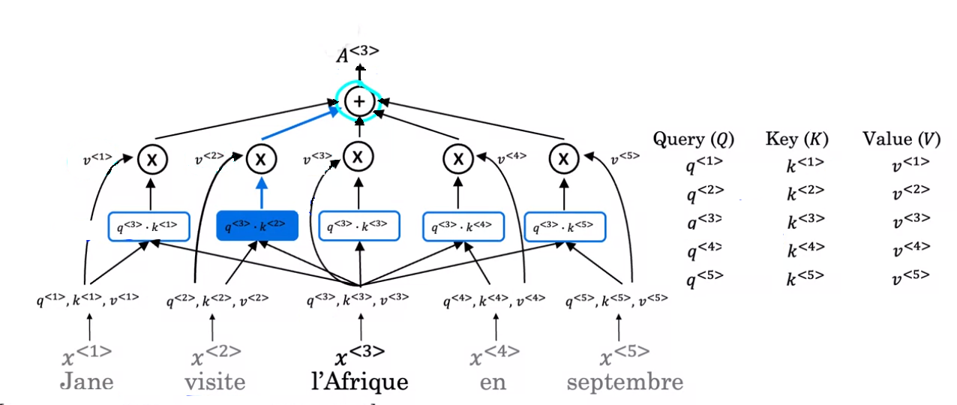
Recap
Encoder-Decoder
Attention
Self Attention
Multi-head Attention
Transformer Architectures

Slide 9
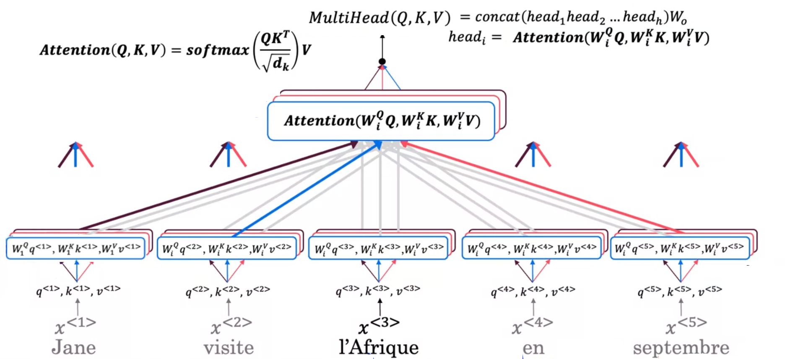
Recap
Encoder-Decoder
Attention
Self Attention
Multi-head Attention
Transformer Architectures

Slide 10
Recap
Encoder-Decoder
Attention
Self Attention
Multi-head Attention
Transformer Architectures

Slide 11

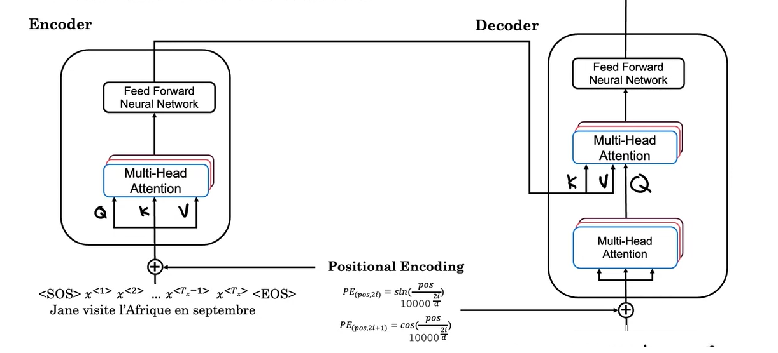
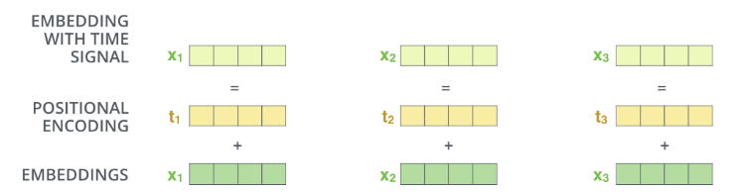

Recap: Transformers
N Times

Slide 12
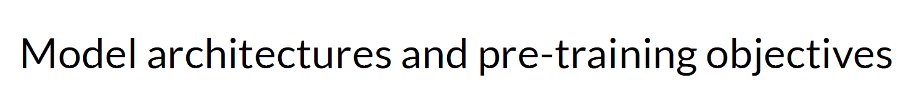

Slide 13
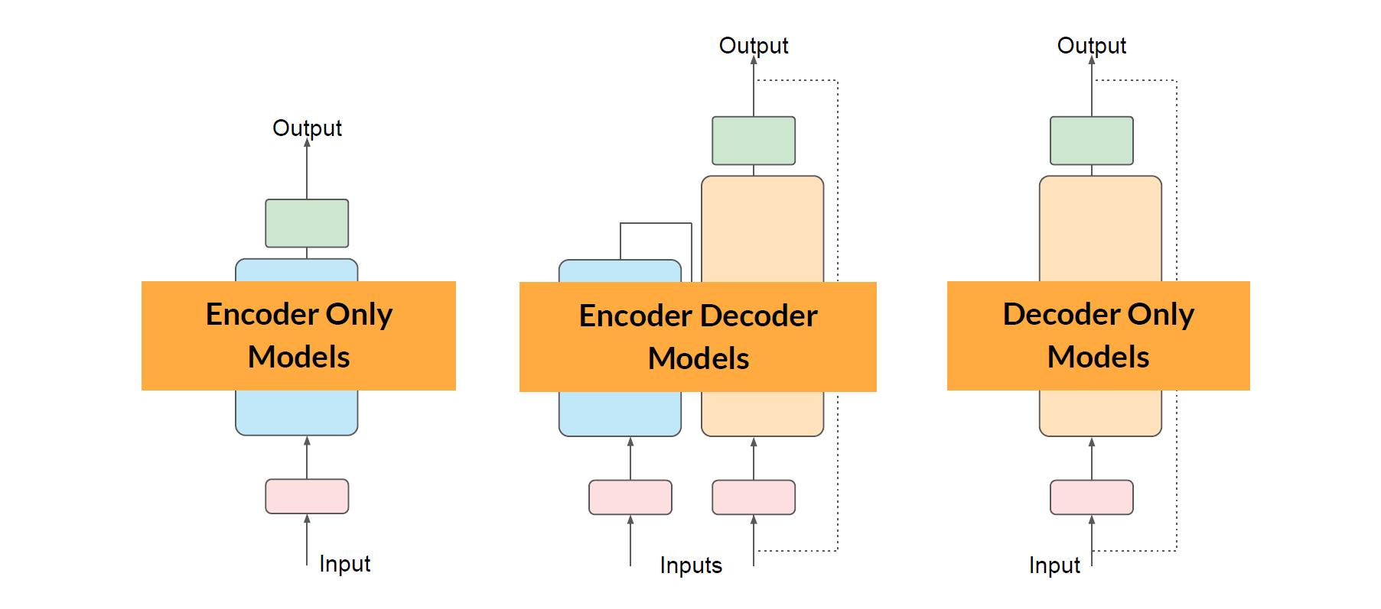
Transformers: Architecture

Slide 14
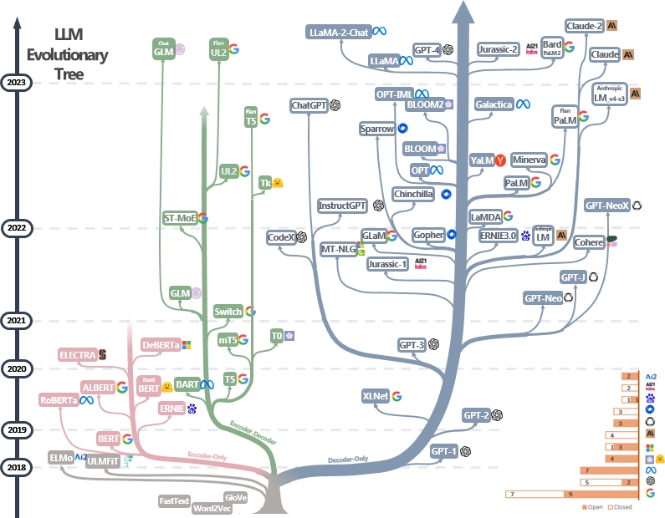
Transformers: Architecture

Slide 15
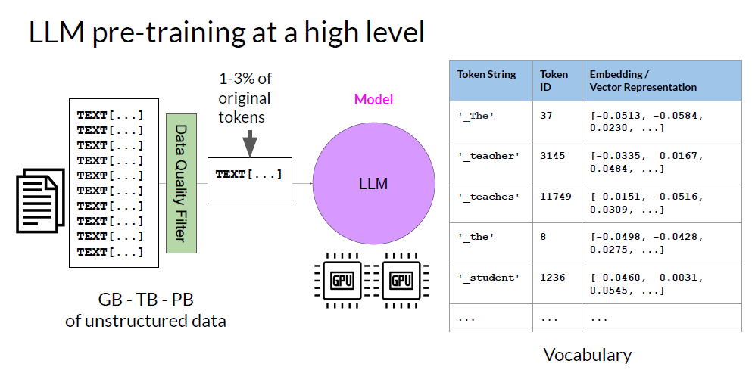

Slide 16
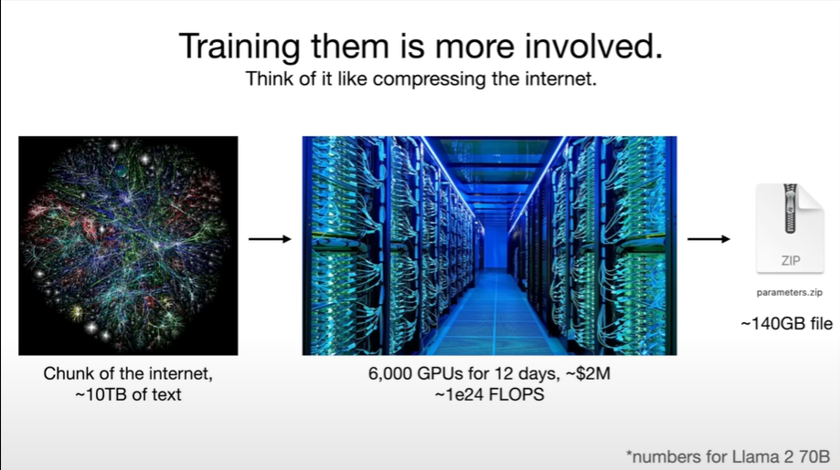
Intro to Large Language Models- Anderj Karpathy

Slide 17
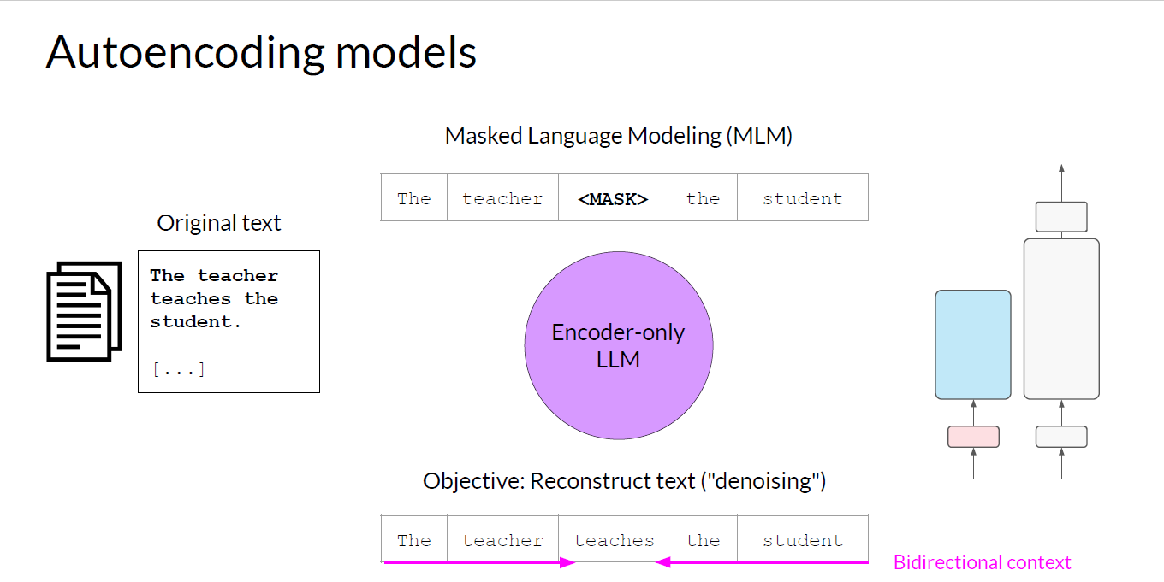
Transformers: Architecture

Slide 18
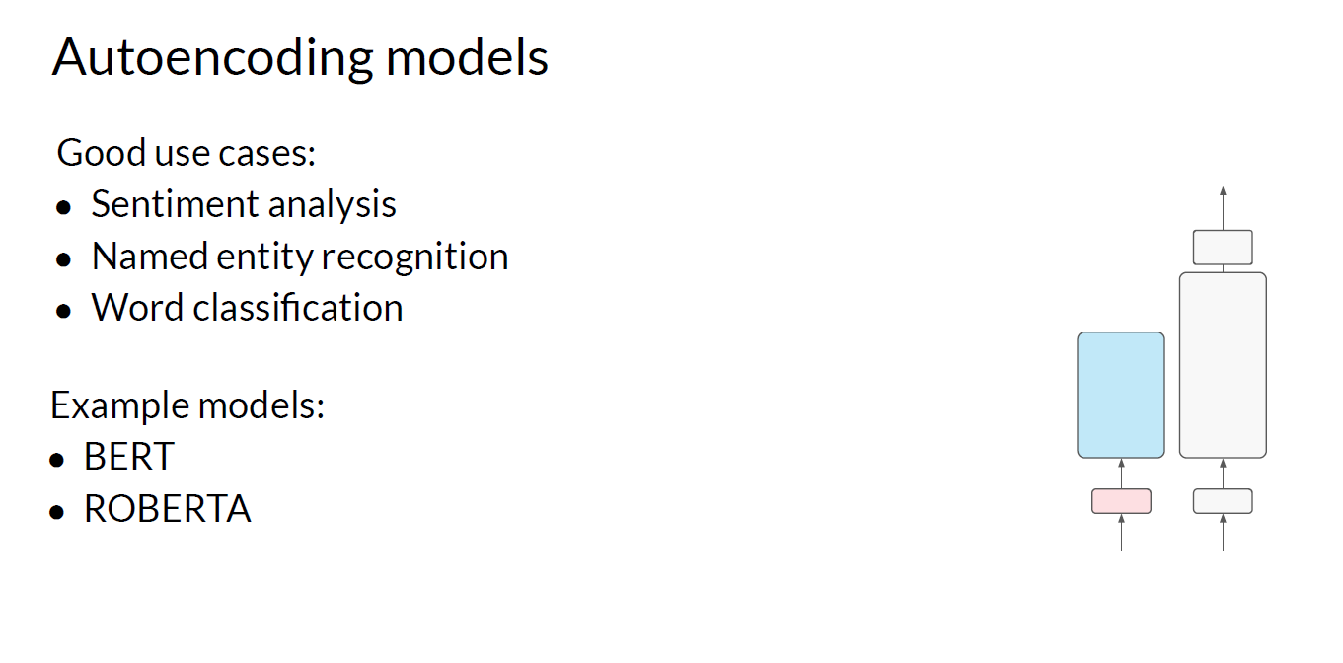
Transformers: Architecture

Slide 19
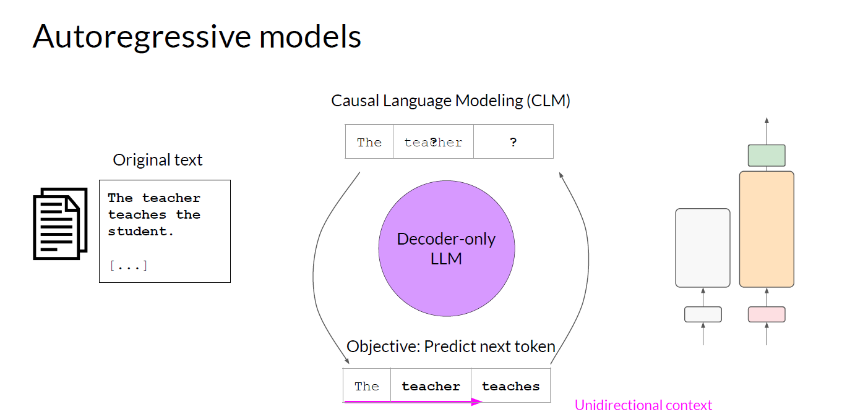
Transformers: Architecture

Slide 20
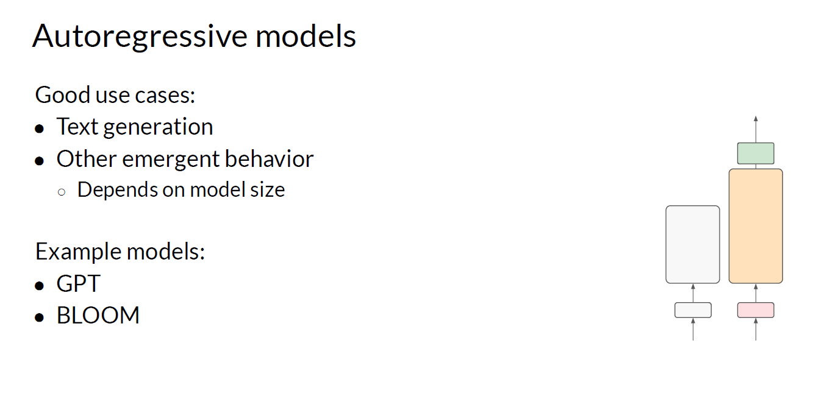
Transformers: Architecture

Slide 21
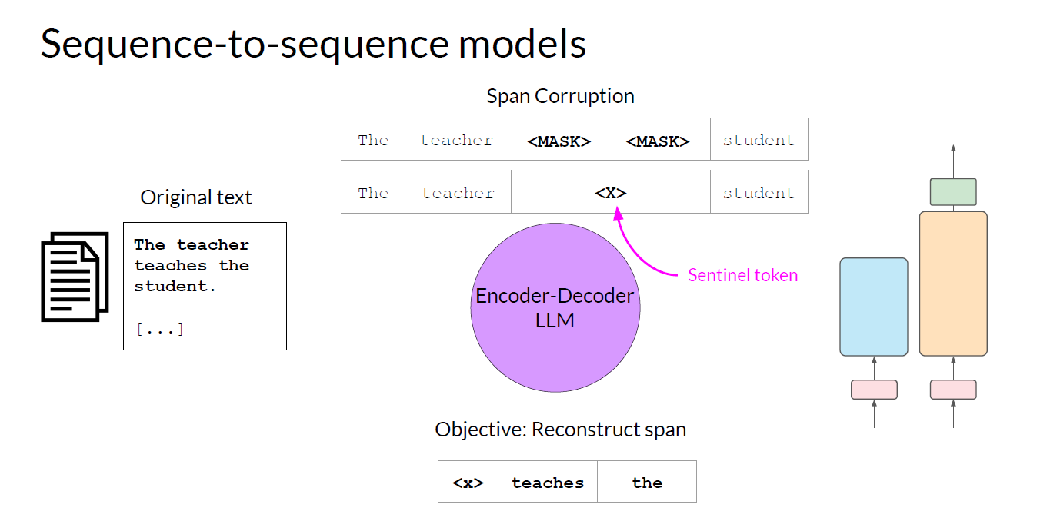
Transformers: Architecture

Slide 22
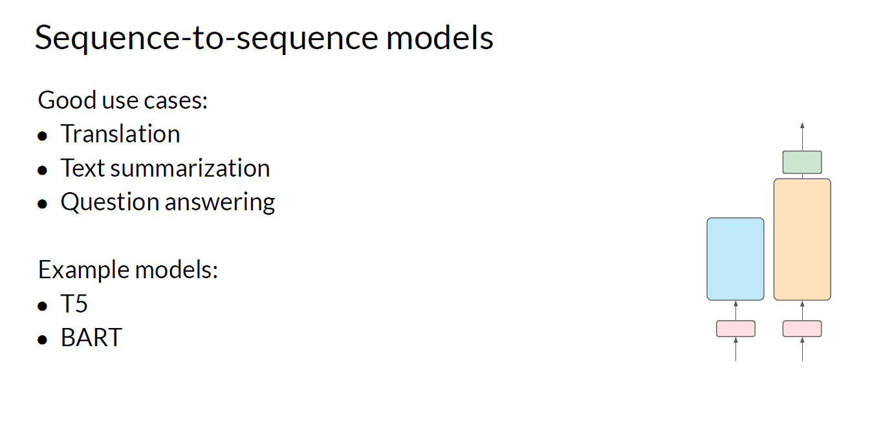
Transformers: Architecture

Slide 23
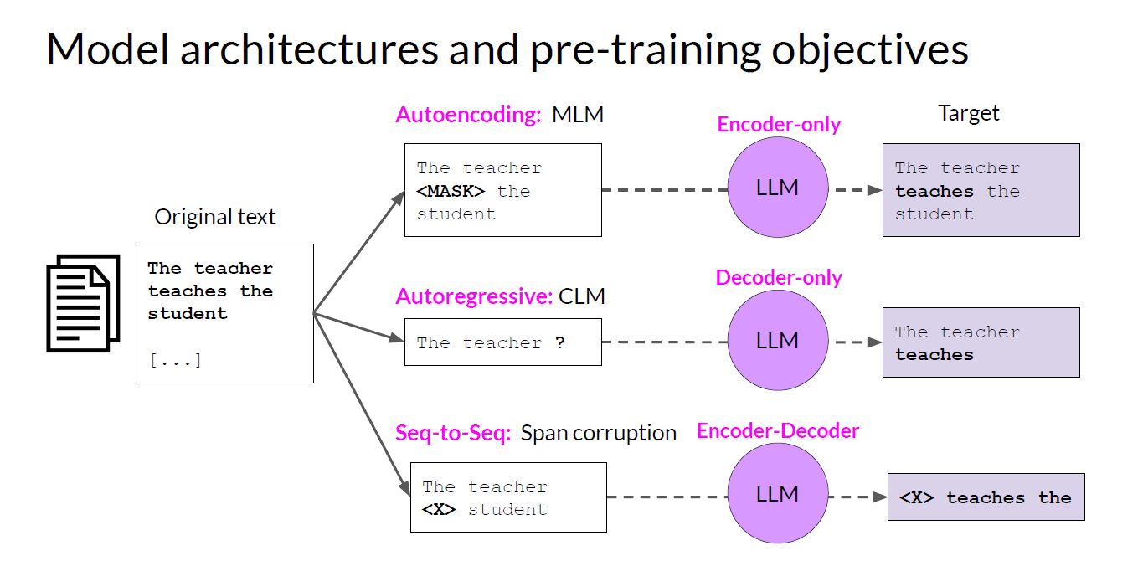
Transformers: Architecture

